Slide 1
SOLAR ENERGY
General Aspects

Slide 2
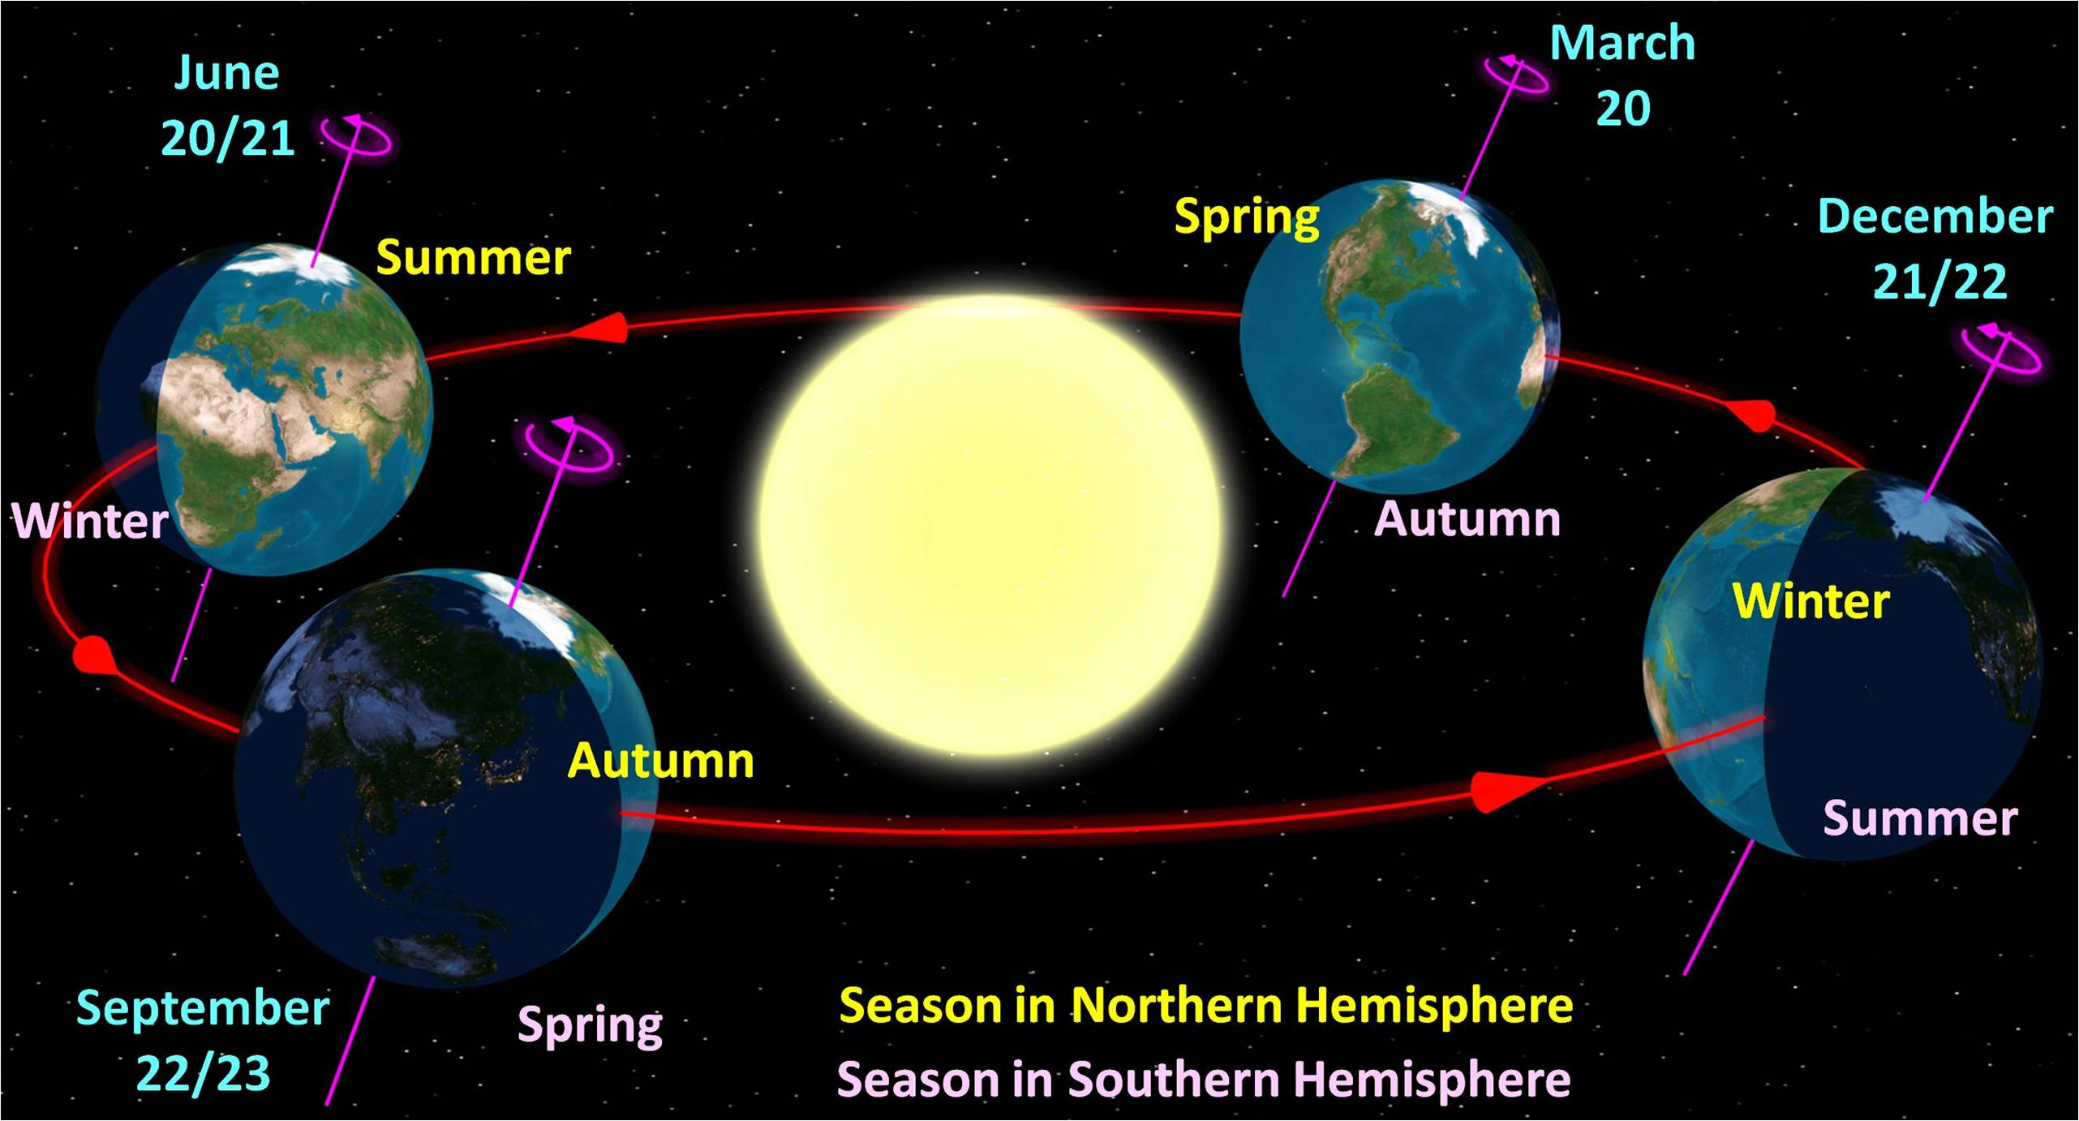
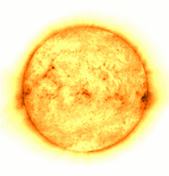

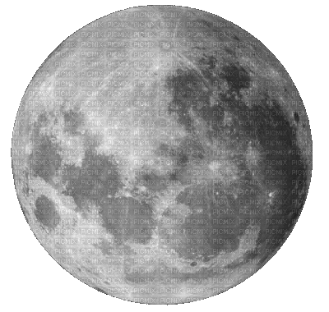
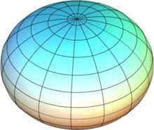
The diameter of the sun is
1.3927 million km
The Earth is Oblate spheroid shape, flattened at the poles and bulged in the plane normal to the poles.
The distance between ‘sun’ and ‘earth is 147.3 million km
Diameter of earth is 12,742 km
Sun completes its one rotation in four weeks when observed from earth.
But the equator of the ‘sun’ takes 27 days and polar regions takes about 30 days for each rotation
The heat generation is mainly due to various kinds of fusion reactions but most of the energy is released in which hydrogen (i.e., four protons) combine to form helium.
An effective black body temperature of sun is 5577 K.
23.5°

Slide 3
Nature of the solar resource Earth is tilted 23.45°
On the winter solstice (December 21)
The north pole has its maximum angle of inclination away from the sun
Everywhere above 66.55°N (90 - 23.45) is in darkness for 24 hours,
Everywhere above 66.55°S is in sunlight for 24 hours
the sun passes directly overhead over the tropic of Capricorn (23.45°S)
On the equinox (March 22 & September 22)
Both poles are equidistant
the day is exactly 12 hours long
the sun passes directly overhead over the equator
The sun tracks a straight line across the sky
On the summer solstice (June 22)
The reverse of the winter solstice

Slide 4
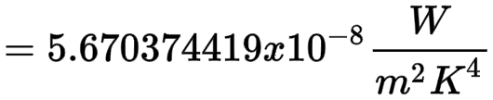
The fusion reaction is as follows:
This energy is produced in the interior of the solar sphere and transmitted out by the radiation into system.
The earth’s inner core is a solid mass made of iron and nickel and the next outer core is melted state of iron and nickel.
The outermost portion is made of rocks.
Half the earth is lit by the sunlight at a time. It reflects one-third of the sunlight that falls on it, is known as earth’s albedo.
The amount of the suns energy that reaches the earth (before entering the atmosphere)
The average value of irradiance per year is called the solar constant (G_{sc}) and is equivalent to 1353, 1367 or 1373 W/m2 depending on who you believe
  1353 (±1.5%) from Thekaekara (1976) – derived from measurements at very high atmosphere and used by NASA
  1367 (±1%) Adopted by the World Radiation Centre
  1373 (±1-2%) from Frohlich (1978) - derived from satellite data

Slide 5
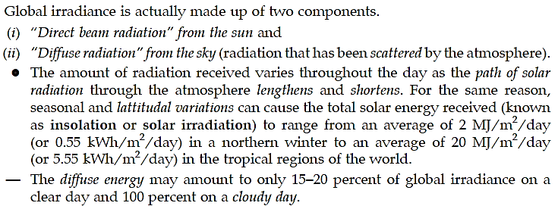
Solar radiation is the energy radiated by the sun.
The radiated energy received on earth surface is called Solar irradiation.
Solar radiation received on a flat horizontal surface on earth is called Solar insolation.
The solar radiation is of the following two types:
Extraterrestrial solar radiation
Terrestrial solar radiation

Slide 6
1. Extraterrestrial solar radiation:
The intensity of sun’s radiation outside the earth’s atmosphere is called “extraterrestrial” and has no diffuse components.
Extraterrestrial radiation is the measure of solar radiation that would be received in the absence of atmosphere.
2. Terrestrial solar radiation:
The radiation received on the earth surface is called “terrestrial radiation” and is nearly 70% of extraterrestrial radiation.
Terms used in solar radiations:

Slide 7
Beam (or direct) radiation (I_{b}): Solar radiation received on the surface of earth without change in directions is known as “beam or direct radiation”.
Diffuse radiation (I_{d}): The solar radiation received from the sun after its direction has been changed by reflection and scattering by atmosphere is known as “diffuse radiation”.
Total radiation (I_{T}): The sum of beam and diffuse radiations intercepted at the surface of earth per unit area of location is known as “total radiation”. It is also known as “Insolation”.
Mathematically: I_{T} = I_{b} + I_{d}
Airmass (ma): It is the path length of radiation through the atmosphere, considering the vertical path at level as unity.
m_{a} = 1, when sun is at zenith (i.e., directly above head).
m_{a} = 2, when zenith angle (θz) is 60°.
m_{a} = sec θz, when m_{a} > 3
m_{a} = 0 just above the earth’s atmosphere
“Reasons for variation in solar radiations reaching the earth than received on the outside of the atmosphere”

Slide 8
As solar radiations pass through the earth’s atmosphere the shortwave ‘ultraviolet rays’ are ‘absorbed’ by ozone in atmosphere and the long wave infrared waves’ are ‘absorbed’ by carbon dioxide and moisture in the atmosphere.
A portion of radiations is ‘scattered’ by the components of atmosphere such as water vapor and dust.
A portion of this scattered radiation always reaches the earth’s surface as ‘diffuse radiation’.
Thus radiations finally received at the earth’s surface consists partly of beam radiation and partly of diffuse radiation.
Where:
G_{on} = Irradiance
G_{sc} = Solar constant
n = Day number (number of days since 1_{st} January)
Note: cosine is for degrees

Slide 9
The “solar constant” (I_{sc}) is the energy from the sun received on a unit area perpendicular to solar rays at the mean distance from the sun (1.5 × 10⁸ km) outside the atmosphere.
Solar constant is characterized by the following:
It is constant and not affected by daily, seasonal, atmospheric condition, clarity of atmosphere etc.
It is on a unit area on imaginary spherical surface around earth’s atmosphere for mean distance between the sun and the earth.
It is on surface normal to sun’s rays. Sun rays are practically parallel (beam radiation).
It has a measured value of “1353 W/m²”.
The value of solar constant remains constant throughout the year.
However, this value changes with location because earth-sun distance changes seasonally with time.
The extraterrestrial relation observed on different days is known as apparent extraterrestrial solar irradiance and can be calculated on any of the year using the following relation:

Slide 10
where,
I₀ = Apparent extraterrestrial solar irradiance (W/m²),
n = Number of days of the year counting January 1 as the first day of the year, and
I_{sc} = Solar constant = 1353 W/m².
(The standard value of the solar constant based on experimental measurements is 1367 W/m² with accuracy of ±1.5%).
According above Equation, the apparent solar irradiance will be maximum during December last or first weak of January as the earth’s center is nearest to the sun during these days.

Slide 11
Clarity Index:
The ratio of radiation received on earth’s horizontal surface over a given period to radiation on equal surface area beyond earth’s atmosphere in direction perpendicular to the beam is called “Clarity index”.
It depends upon the clarity of atmosphere for passage of solar beam radiation. Clarity index can be between 0.1 to 0.7.
Concentration ratio:
It is the ratio of solar power per unit area of the concentrator surface (kW/m²) to power per unit area on the line focus or point focus (kW/m²).

Slide 12
The various angles which are useful for conversion of beam radiation on the arbitrary surface are:
Latitude angle (ϕ):
The ‘latitude of a place’ is the angle subtended by the radial line joining the place to the centre of the earth, with the projection of the line on the equatorial plane.
The latitude is taken as positive for any location towards the ‘northern hemisphere’ and negative towards the ‘southern hemisphere’ i.e., the latitude(s) at equator is 0⁰ while at north and south poles are + 90° and – 90° respectively.
Declination angle (d):
It is the angle made by the line joining the centres of the sun and the earth with its projection on the equatorial plane.
This angle varies from a maximum value of +23.5° on June 21 to minimum of –23.5° on December 21.
The declination (in degrees) for any day may be calculated from the approximate equation of “Cooper”.

Slide 13
Hour angle (ω):
It is angle through which the earth must be rotated to bring the meridian of the plane directly under the sun.
In other words, it is the angular displacement of the sun, east or west of the local meridian, due to rotation of the earth on its axis at an angle of 15° per hour.
It is measured from noon based on the local solar time (LST) or local apparent time (LAT), being positive in the morning and negative in the afternoon.
It is the angle measured in the earth’s equilateral plane, between the projection OP and the projection of a line from the center of the sun to the center of the earth.
At solar noon w being zero and each hour angle equating 15° of longitude with “morning positive” and “afternoon negative” (e.g. w = + 15° for 11.00 and ω = – 37.5° for 14.30), hour angle can be expressed as : ω = 15 (12– LST)
Altitude angle (α) or solar altitude:
It is a vertical angle between the projection of the sun rays on the horizontal plane and
direction of the sunrays, passing through the point.
Zenith angle (θ_{z}): It is a vertical angle between sun’s rays and a line perpendicular to the horizontal plane through the point.
Mathematically,

Slide 14
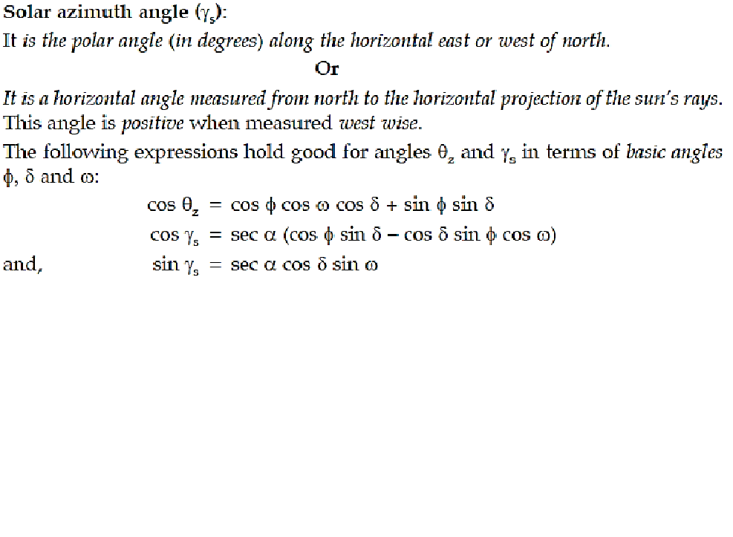
Surface azimuth angle (γ):
It is the angle of deviation of the normal to the surface from the local meridian, the zero point being south, east positive and west negative.
Slope or tilt angle (β):
It is the angle made by the plane surface with the horizontal.
It is taken to be positive for surfaces sloping towards the south and negative for surfaces sloping towards north.
Incident angle (θ):
It is the angle being measured between beam of rays and normal to the plane.

Slide 19
Solar Day-Length, Sunrise and Sunset:
We make the following observations:
During ‘winter’ the sun rises late and sets early, the day length is shorter.
During ‘summer’ sun rises early, sets late and day length is longer.
With the increase of the angle of latitude (from equator to north pole) the difference in day length between summer and winter becomes more and more prominent.
The ‘sunrise hour’ ‘sunset hour’ and ‘day-length’ depend upon latitude of the location and season and day in the year.
The expressions are derived as follows:
For a horizontal surface on the ground Eqn. (Earlier slide) is written as
(For sunrise and sun set the hour angle is designated as ω_{s})
The hour angle ω varies during the day.
At sunrise, as the sun light is parallel to the ground surface, therefore, angle of incidence θ = 90°, cos θ = 0
Inserting this value in

Slide 20
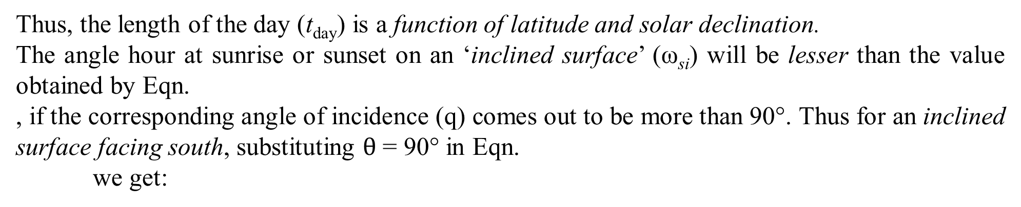
Thus, the length of the day (t_{day}) is a function of latitude and solar declination.
The angle hour at sunrise or sunset on an ‘inclined surface’ (ω_{si}) will be lesser than the value obtained by Eqn.
, if the corresponding angle of incidence (q) comes out to be more than 90°. Thus for an inclined surface facing south, substituting $θ$ = 90° in Eqn.
we get:

Slide 21
Determine the sunset hour angle and day-length at a location latitude of 32° on March 30.
Determine the day-length in hours at Delhi (latitude = 28.6°) on June 28 in a leap year.
Calculate Local Apparent Time (LAT) and declination at a location latitude 24° 20’ N, longitude 77°30’E at 12.30 IST on July 24. Equation of time correction = – (1’ 06”).

